Slide 1
Chapter 1
Introduction to
Organizational Behavior
1-<number>

Slide 2
After reading this chapter, you should be able to:
Define organizational behavior (OB).
Explain the value of the systematic study of OB.
Identify the contributions made to OB by major behavioral science disciplines.
Describe how OB concepts can help make organizations more productive.
List the major challenges and opportunities for managers to use OB concepts.
Identify the three levels of analysis in OB.
1-<number>

Slide 3
The Field of Organizational Behavior
Organizational Behavior studies the influence that individuals, groups and structure have on behavior within organizations.
Its chief goal is to apply that knowledge toward improving an organization’s effectiveness.
1-<number>

Slide 4

Focal Points of OB
Jobs
Work
Absenteeism
Employment turnover
Productivity
Human performance
Management
1-<number>

Slide 5
Complementing Intuition with Systematic Study
Intuition: the “gut feeling” explanation of behavior.
Systematic study improves ability to accurately predict behavior.
  Assumes behavior is not random.
  Fundamental consistencies underlie behavior.
  These can be identified and modified to reflect individual differences.
1-<number>

Slide 6

Systematic Study
Examines relationships.
Attempts to attribute causes and effects.
Bases conclusions on scientific evidence:
  On data gathered under controlled conditions.
  Data is measured and interpreted in a reasonably rigorous manner.
1-<number>

Slide 7

Evidence-Based Management
Complements systematic study.
Bases decisions on the best available scientific evidence.
Forces managers to become more scientific in their thinking.
1-<number>

Slide 8
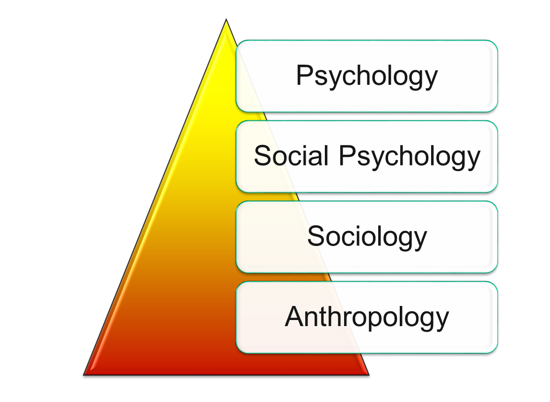
Contributing Disciplines to the OB Field
Micro:
The Individual
Macro:
Groups &
Organizations
1-<number>

Slide 9
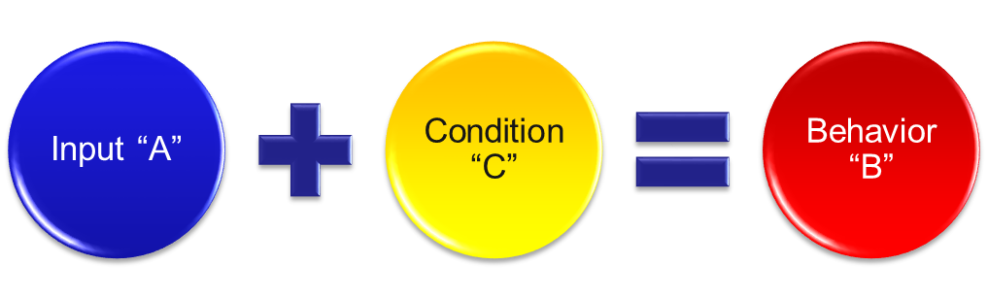
Few Absolutes in OB
Impossible to make simple and accurate generalizations
Human beings are complex and diverse
OB concepts must reflect situational conditions: contingency variables
1-<number>

Slide 10
Challenges and Opportunities for OB
The workplace is contains a wide mix of cultures, races, ethnic groups, genders and ages
Employees have to learn to cope with rapid change due to global competition
Corporate loyalty has decreased due to corporate downsizing and use of temp workers
Managers can benefit from OB theory and concepts
1-<number>

Slide 11

Responding to Globalization
Increased foreign assignments
  Differing needs and aspirations in workforce
Working with people from different cultures
  Domestic motivational techniques and managerial styles may not work
Overseeing movement of jobs to countries with low-cost labor
1-<number>

Slide 12

Managing Workforce Diversity
Workforce diversity:
organizations are becoming a more heterogeneous mix of people in terms of gender, age, race, ethnicity, and sexual orientation
1-<number>

Slide 13

Diversity Implications
“Managers have to shift their philosophy from treating everyone alike to recognizing differences and responding to those differences in ways that ensure employee retention and greater productivity while, at the same time, not discriminating.”
1-<number>

Slide 14

OB Offers Insights Into:
Improving quality and productivity
Customer service and building a customer-responsive culture
Developing people skills
1-<number>

Slide 15

OB Aids in Dealing With:
Stimulating Innovation and Change
Increasing “temporariness” in the workplace
Helping employees balance work-life conflicts
Improving ethical behavior
1-<number>

Slide 16
Thinking Positive
Creating a positive work environment can be a competitive advantage
Positive Organizational Scholarship (Positive OB):
  Examines how organizations develop human strengths, foster vitality and resilience, and unlock potential.
  Focus is on employee strengths, not their weaknesses.
1-<number>

Slide 17
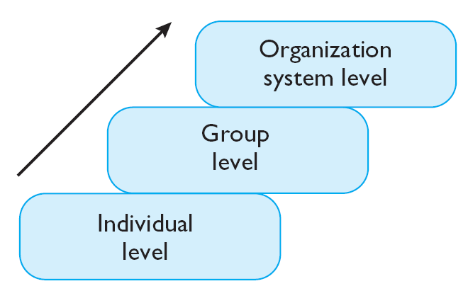
Three Levels of OB Analysis
Chapters 14 - 16
Chapters 8 - 13
Chapters 2 - 7
Plan of the Book
1-<number>

Slide 18

Implications for Managers
OB helps with:
  Insights to improve people skills
  Valuing of workforce diversity
  Empowering people and creating a positive work environment
  Dealing with labor shortages
  Coping in a world of temporariness
  Creating an ethically healthy work environment
1-<number>

Slide 19
Keep in Mind…
OB’s goal is to understand and predict human behavior in organizations.
Fundamental consistencies underlie behavior.
It is more important than ever to learn OB concepts.
Both managers and employees must learn to cope with temporariness.
1-<number>

Slide 20
Summary
Defined Organizational Behavior (OB).
Explained the value of the systematic study of OB.
Identified the contributions made to OB by major behavioral science disciplines.
Described how OB concepts can help make organizations more productive.
Listed the major challenges and opportunities for managers to use OB concepts.
Identified the three levels of analysis in OB.
1-<number>

